Slide 1

Data Acquisition And Wrangling
Nexthikes It Solution
Riddhima Maheshwari

Slide 2
Overview of the Final Merged Dataset
This dataset is a bike-sharing or transportation-related dataset, likely capturing hourly or daily rental trends based on various environmental and temporal factors. Below is an overview of the key columns:
Column Name | Description
cnt | Total count of bike rentals (casual + registered).
instant | Unique identifier for each record (row)
dteday | The date corresponding to the record
season | Season indicator (1: Spring, 2: Summer, 3: Fall, 4: Winter).
yr | Year (0: 2011, 1: 2012).
mnth | Month (1 = January, 12 = December).
hr | Hour of the day (0 to 23, representing 24-hour format).
holiday | Whether the day is a holiday (1) or not (0).
weekday | Day of the week (0: Sunday, 6: Saturday).
weathersit | Weather situation (1: Clear, 2: Misty, 3: Light Rain/Snow, 4: Heavy Rain/Snow).
temp | Normalized temperature (0 to 1, where 1 = 41°C or max recorded temperature).
atemp | Normalized "feels-like" temperature.
hum | Normalized humidity value (0 to 1).
windspeed | Normalized wind speed (0 to 1).
casual | Number of casual (non-registered) users renting bikes.
Registered | Number of registered users renting bikes.

Slide 3
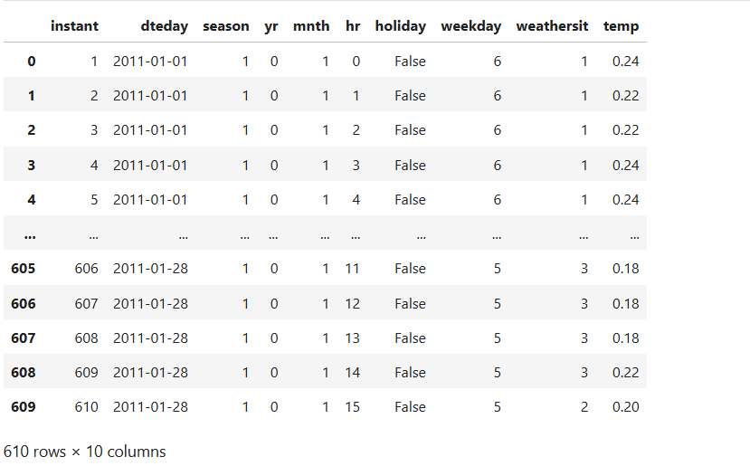
Dataset 1
Overview of Dataset 1
Dataset 1 contains bike rental records for January 2011, including details on time, temperature, and weather conditions.
The data focuses on hourly observations, helping analyze temperature variations and weather effects on bike rentals.

Slide 4
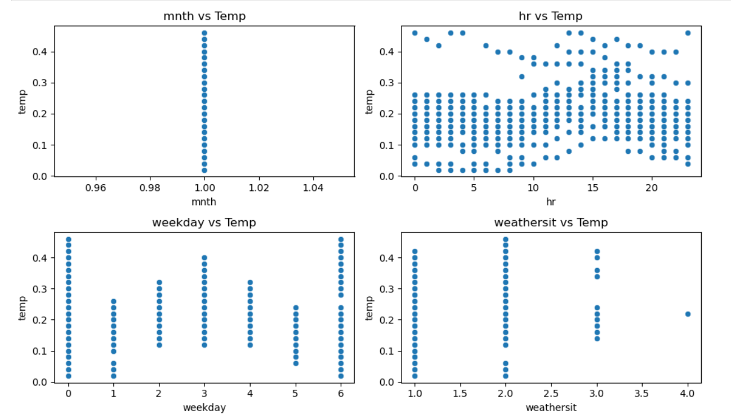
Exploratory Data Analysis – Dataset 1
Checked for missing values using fillna().sum() → No missing values found.
Scatter plots created to understand relationships between temperature (temp) and:
mnth → Dataset contains only January data.
hr → Temperature follows a daily cycle (cooler at night, warmer in the afternoon).
weekday → No major temperature variation across weekdays.
weathersit → Higher temperatures on clear days, lower on rainy/snowy days.
3. Histogram plotted to understand the distribution of numerical features.
Helps visualize how temp,hr,other numerical variables are spread

Slide 5
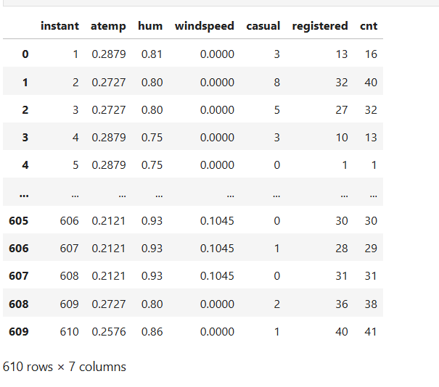
DATASET 2
Overview of Dataset 2
Dataset 2 contains bike rental data, focusing on environmental factors such as atemp (feels-like temperature), humidity (hum), and windspeed.
The dataset is structured to analyze how weather conditions affect bike usage.
Column Unnamed: 0 was removed as it was unnecessary
Checked for missing values → Missing values found in atemp, replaced with the median value.

Slide 6
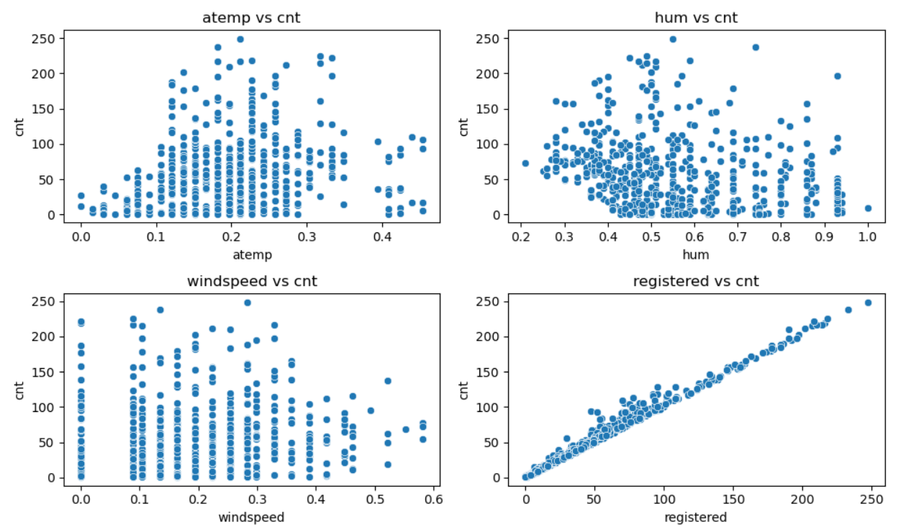
Exploratory Data Analysis - Dataset 2
Scatter plots created to explore relationships with cnt (total rentals):
cnt vs. atemp → More rentals occur at moderate feels-like temperatures.
cnt vs. hum → Humidity affects rentals, with extreme values showing fewer rides.
cnt vs. windspeed → Rentals decrease as wind speed increases, indicating weather impact.
cnt vs. registered → Strong positive correlation, meaning registered users contribute most to total rentals.
Histogram plotted to check the distribution of numerical variables.
Helps understand the spread and skewness of attributes like humidity, windspeed, and cnt.

Slide 7
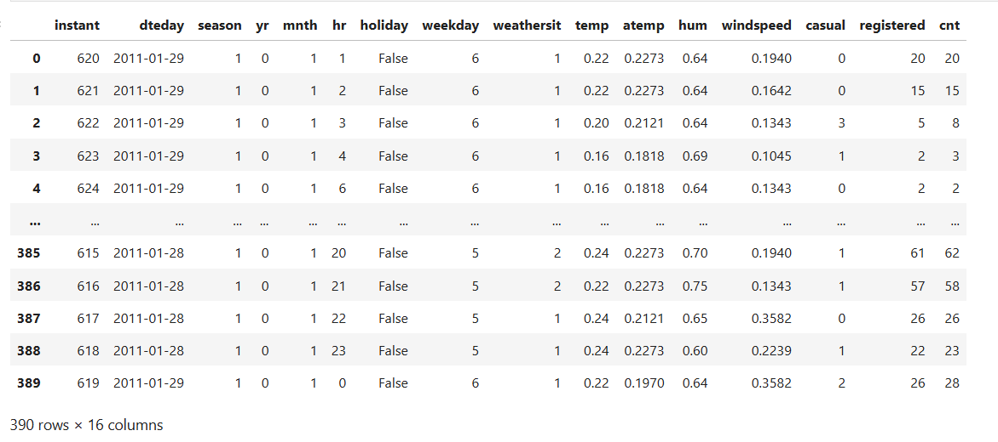
Dataset 3
Overview of Dataset 3
Dataset 3 contains bike rental data with time-based features (season, yr, mnth, hr) and weather conditions (temp, atemp, hum, windspeed).
It consists of 390 rows and 10 columns, expanding the dataset with additional observations.
No missing values were found, ensuring data consistency.

Slide 8
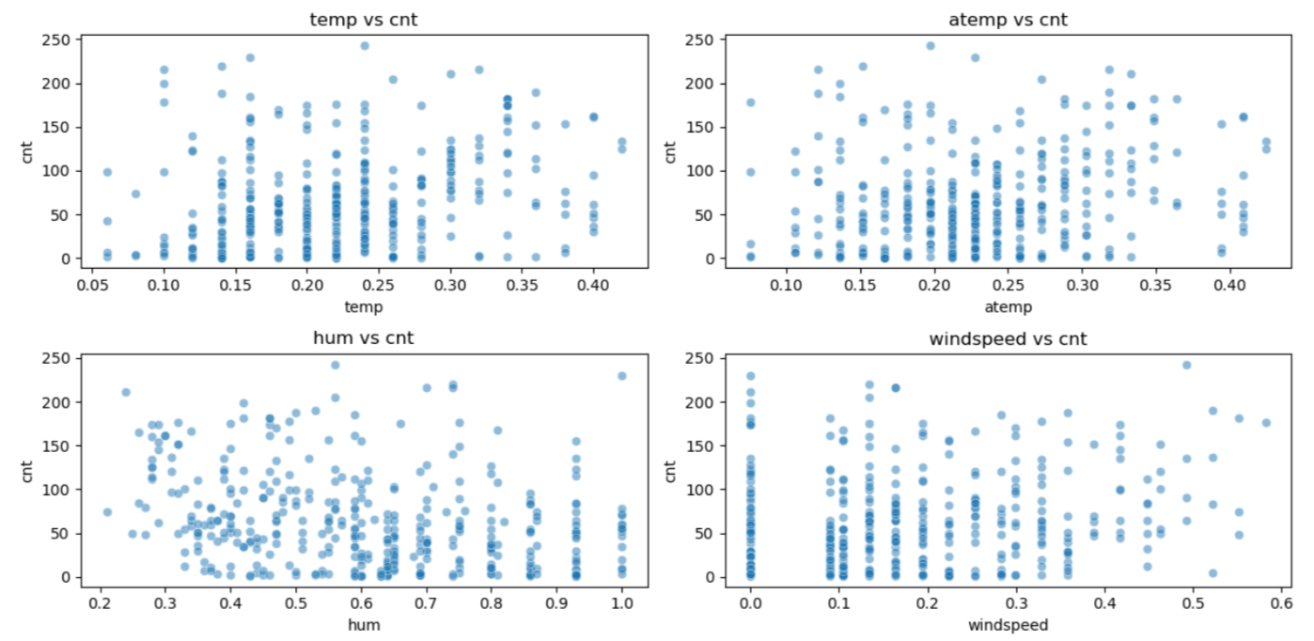
Exploratory Data Analysis – Dataset 3
Scatter plots explored relationships with cnt (total rentals):
cnt vs. temp & cnt vs. atemp → More rentals at moderate temperatures.
cnt vs. hum → High humidity may reduce rentals.
cnt vs. windspeed → Increased windspeed correlates with fewer rentals.

Slide 9
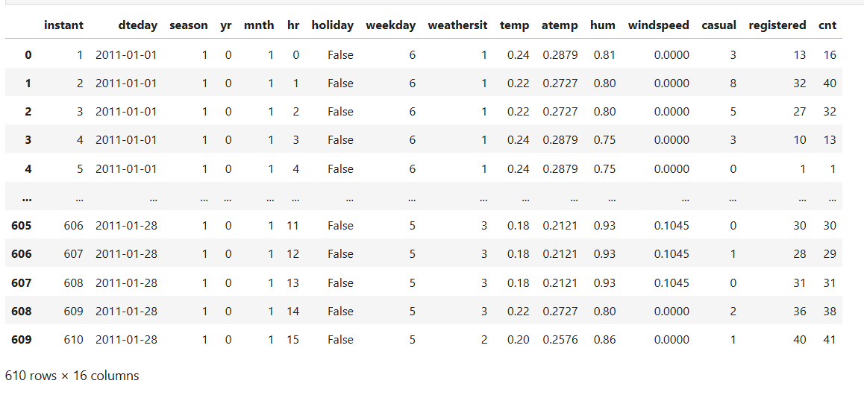
Merged Dataset Overview
Merged Dataset is created by combining Dataset 1 and Dataset 2 using an inner join on the instant column.
The dataset contains no missing values after merging.

Slide 10
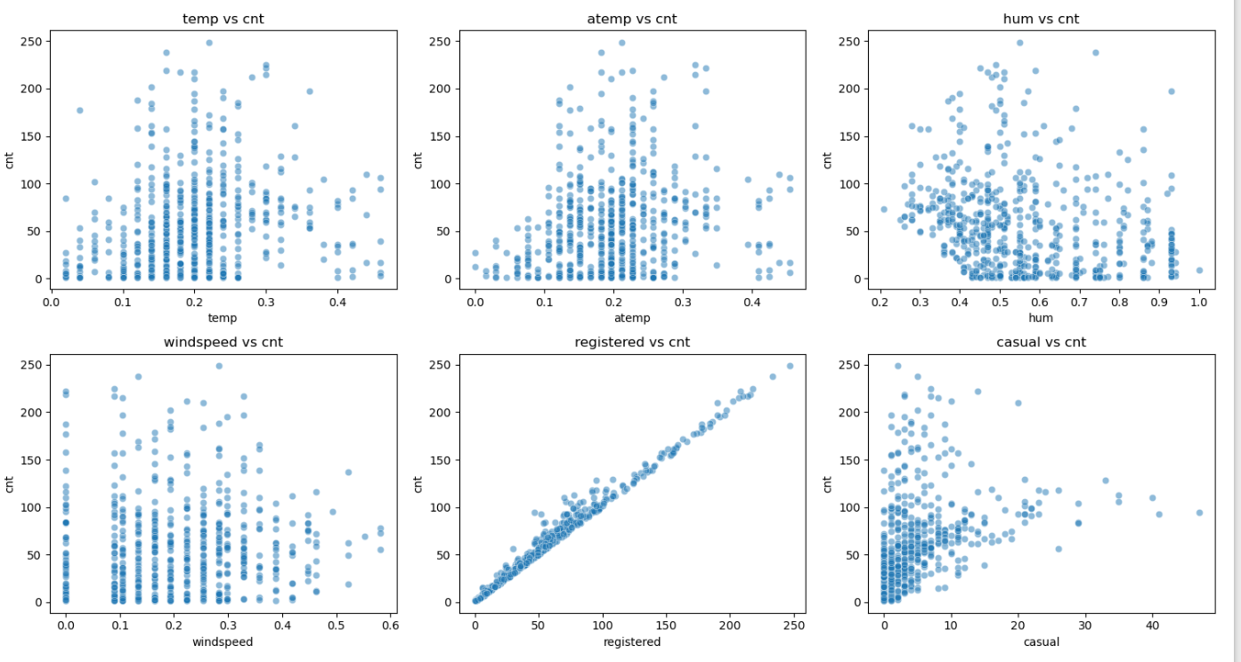
Exploratory Data Analysis - Merged Dataset
Scatter plots were generated to analyze relationships between key variables:
Temperature vs. Count
Atemp vs. Count
Humidity vs. Count
Windspeed vs. Count
Registered Users vs. Count
2. Histogram plotted to analyze the distribution of numerical features (temp, atemp, hum, windspeed, casual, registered, cnt).

Slide 11
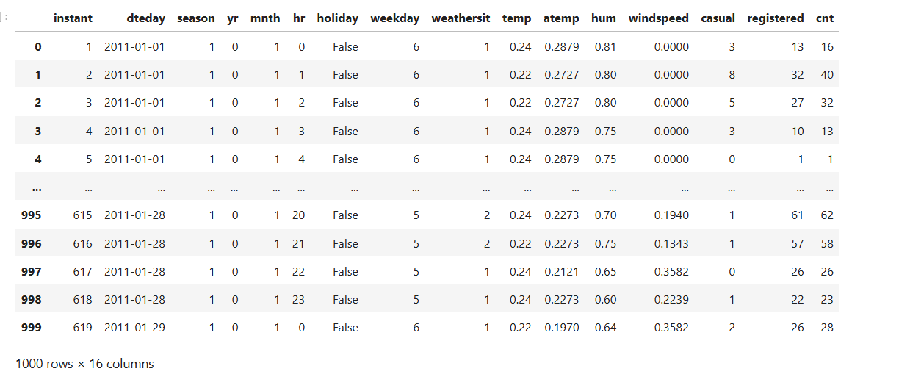
Final merged dataset
The dataset is created by merging previous merged dataset and Dataset 3.
No missing values were found after merging.
The dataset now contains combined features from both datasets, allowing for better analysis.

Slide 12
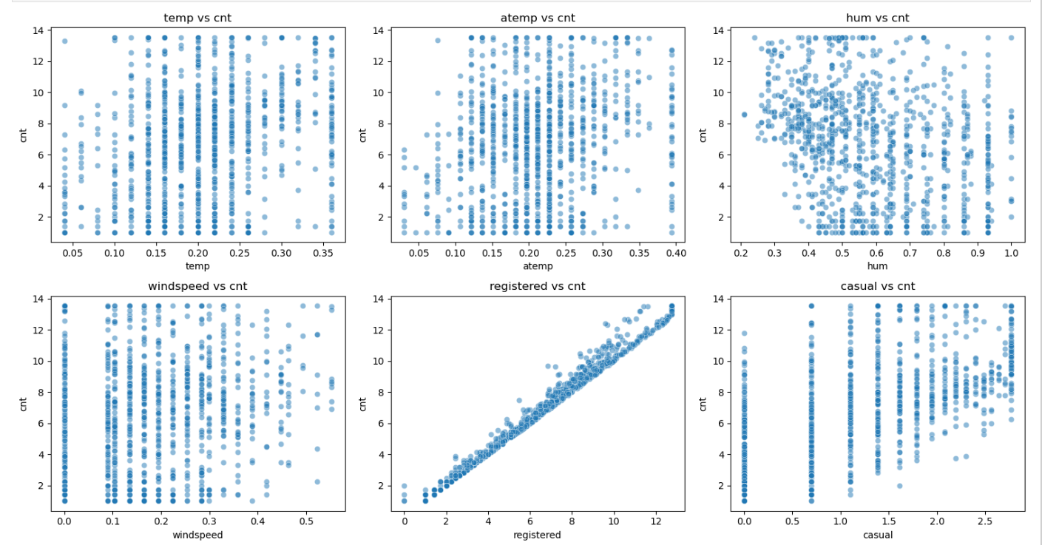
Exploratory Data Analysis - Final Merged Dataset Data Analysis - Merged Dataset
Scatter Plot Analysis
Analyzed variable relationships using scatter plots.
Temp vs Count: Higher temp increases rentals but extreme values reduce it.
Humidity vs Count: Higher humidity lowers rentals.
Windspeed vs Count: No strong correlation.
Registered Users vs Count: Strong positive correlation.
Casual Users vs Count: More scattered and unpredictable.
Histogram
Histogram plotted to analyze the distribution of numerical features (temp, windspeed, cnt, atemp, hum).

Slide 13
Outliers and correlation of final dataset
Outliers
Boxplots were used to identify outliers in the dataset.
Casual riders and windspeed show significant outliers, indicating extreme values in these features.
Outliers were capped to reduce their impact on model performance
Correlation
Registered users highly correlate with cnt, driving total rentals.
temp and atemp moderately affect cnt, indicating weather impact.
windspeed and hum show weak correlation, suggesting minimal influence.

Slide 14
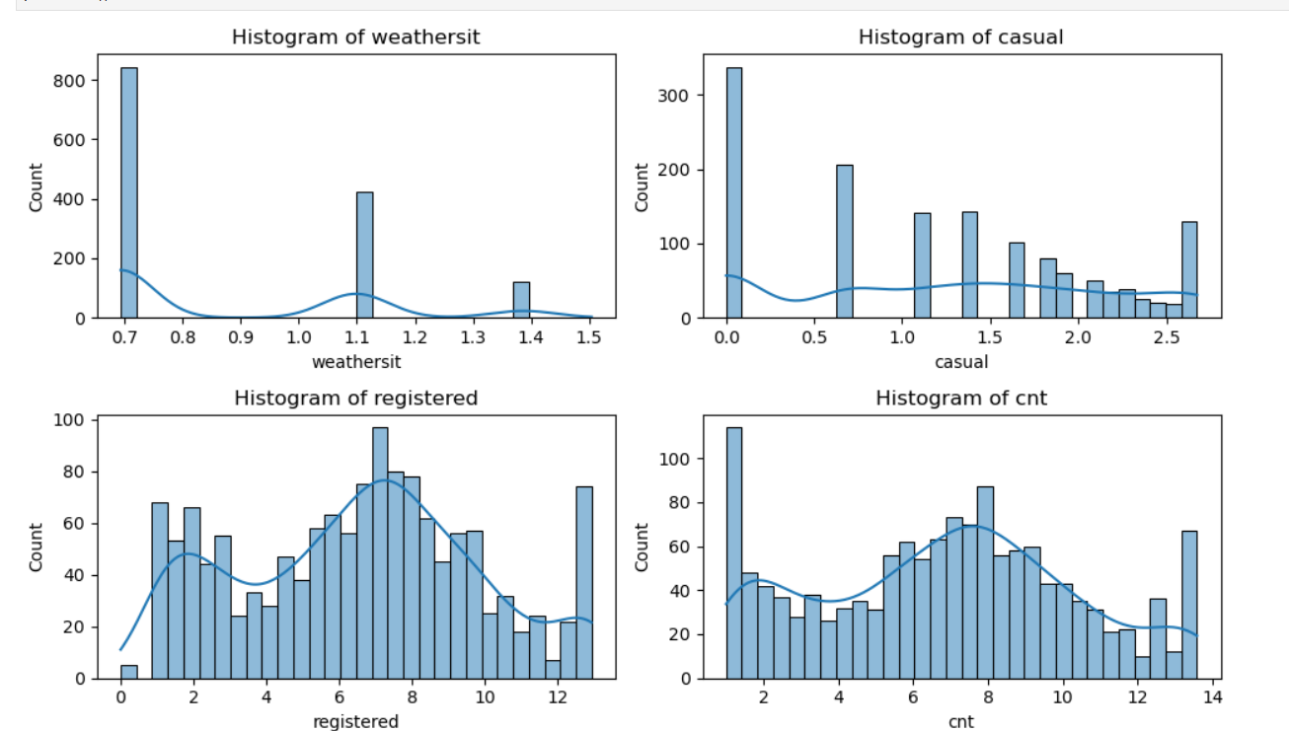
Skewness of final dataset
Casual, registered, and cnt are positively skewed (>0.5), indicating a right-skewed distribution.
Weathersit and casual have high skewness, suggesting possible outliers or imbalance.
Most other features are near normal, with minor skewness in temp, atemp, and hum.

Slide 15

references
https://www.geeksforgeeks.org/what-is-data-acquisition-in-machine-learning/
https://www.geeksforgeeks.org/data-wrangling-in-python/

Slide 16

Thankyou

